Slide 1
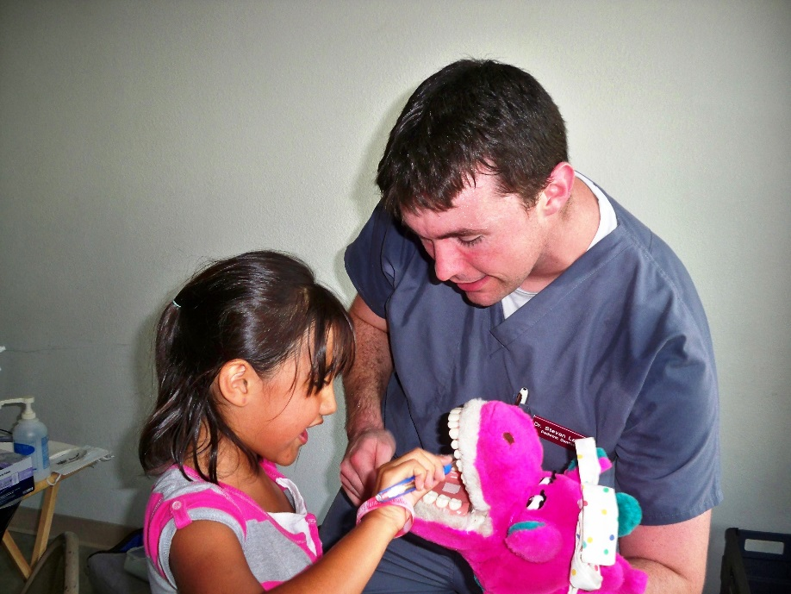
Oral Health Education

Slide 2
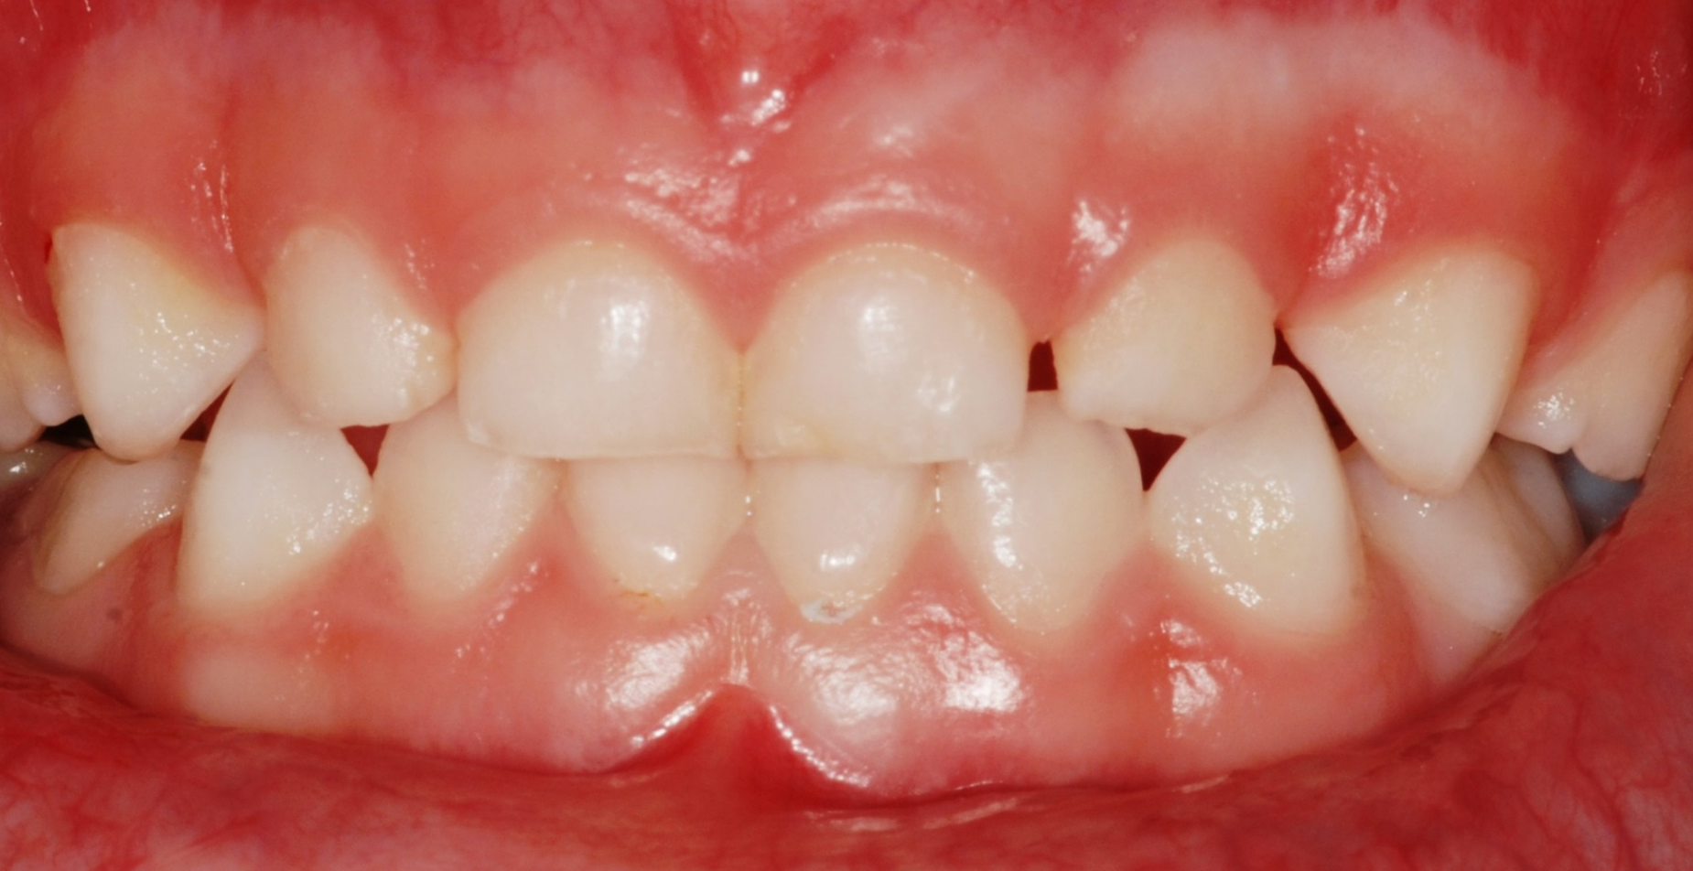
Why are teeth important?
What jobs do they do for us?

Slide 3

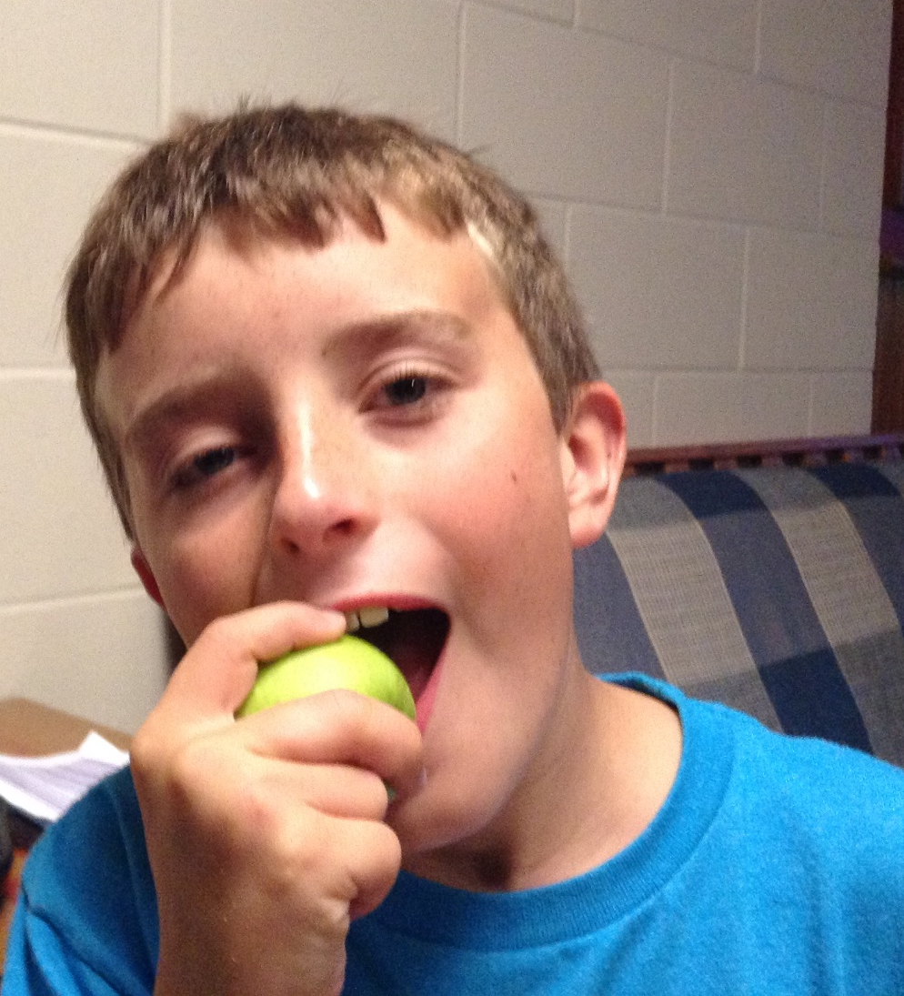
Eating

Slide 4

Talking

Slide 5

Smiling

Slide 6
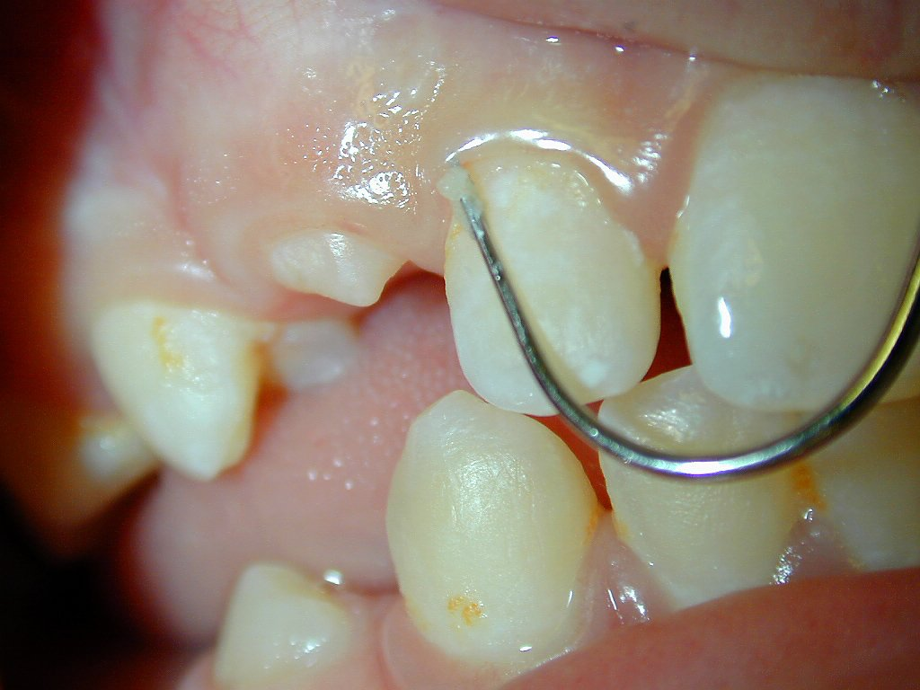
What is the name of the sticky goo that forms on our teeth every day?

Slide 7
PLAQUE

Slide 8

There are three ingredients in plaque.
What are they?

Slide 9

PLAQUE
Bacteria (Germs)
Food (especially sugar)
Saliva

Slide 10
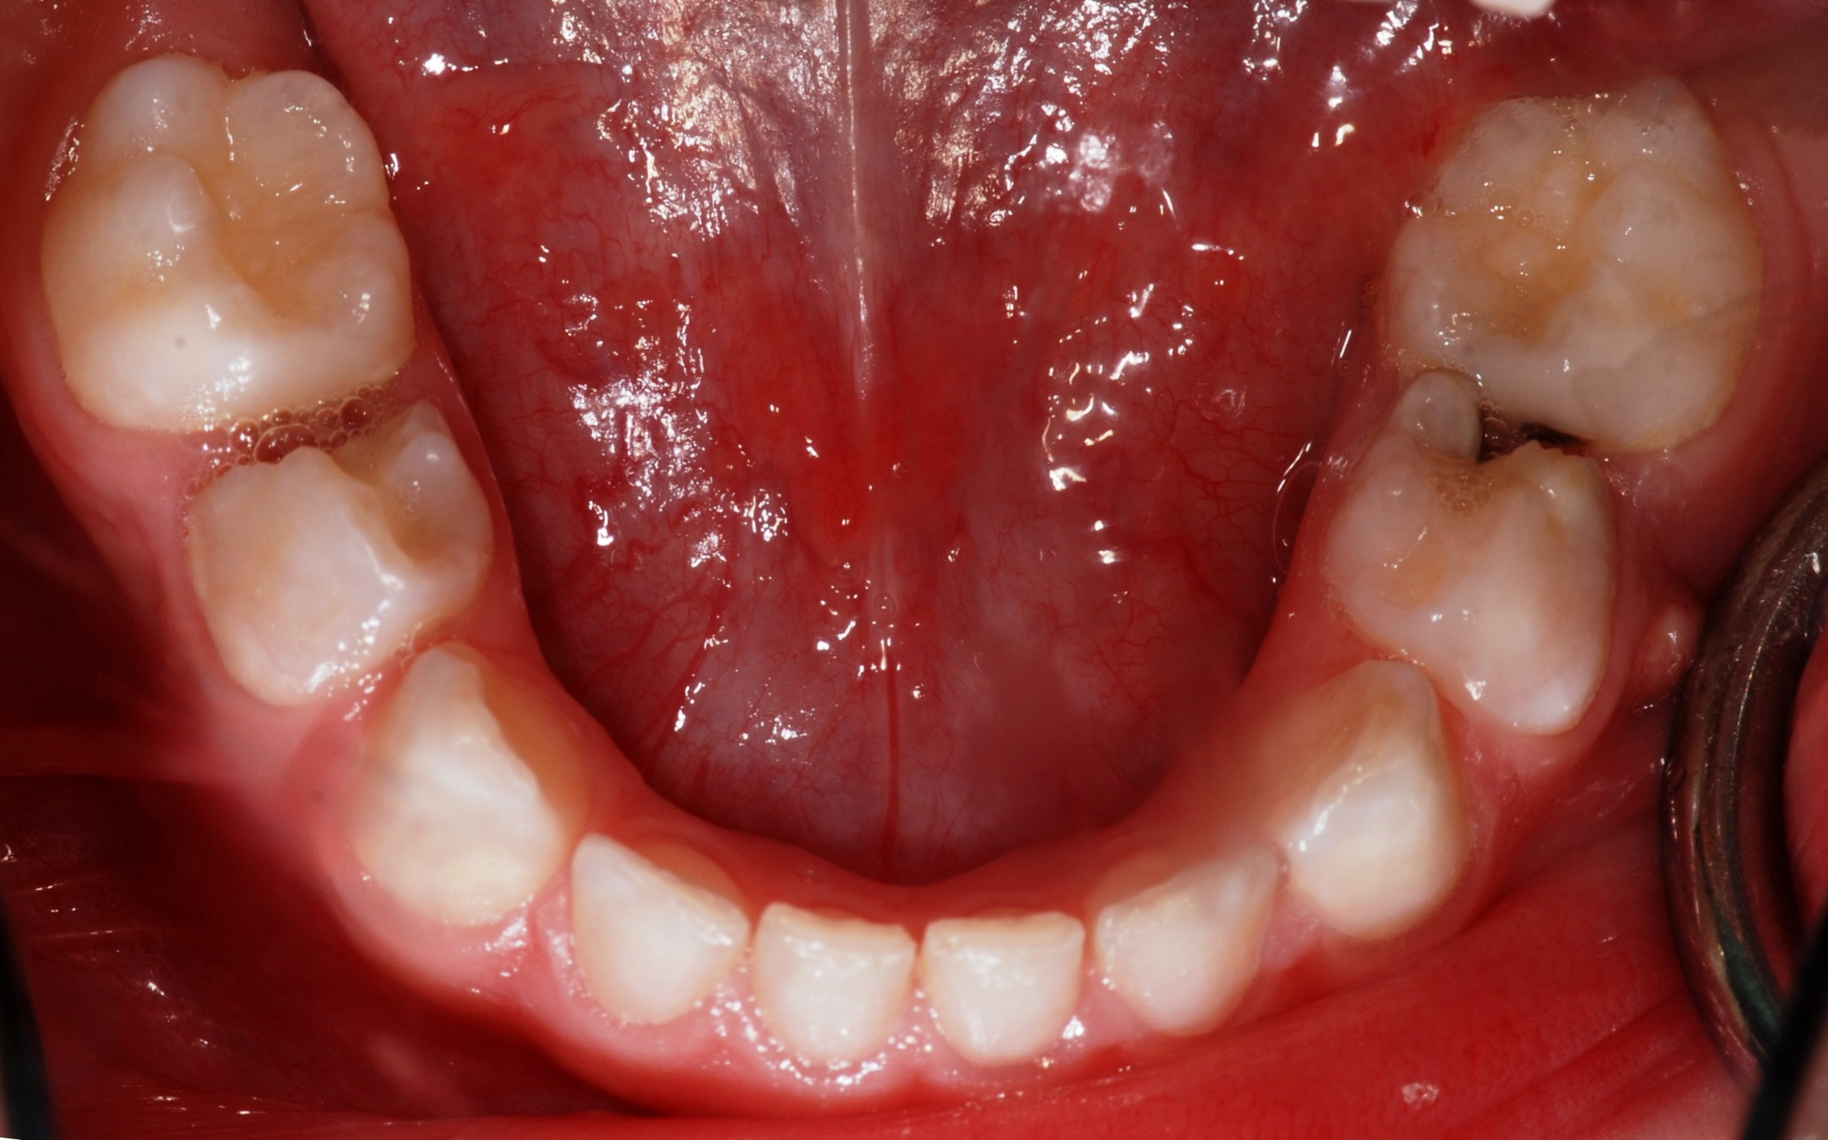
How does plaque make a cavity?

Slide 11

How does plaque make a cavity?
Germs (bacteria) PLAQUE
+
SUGAR
=
Acid

Slide 12
Acid +Tooth
=
Cavity
(Tooth Decay)

Slide 13
Decay
Decay

Slide 14
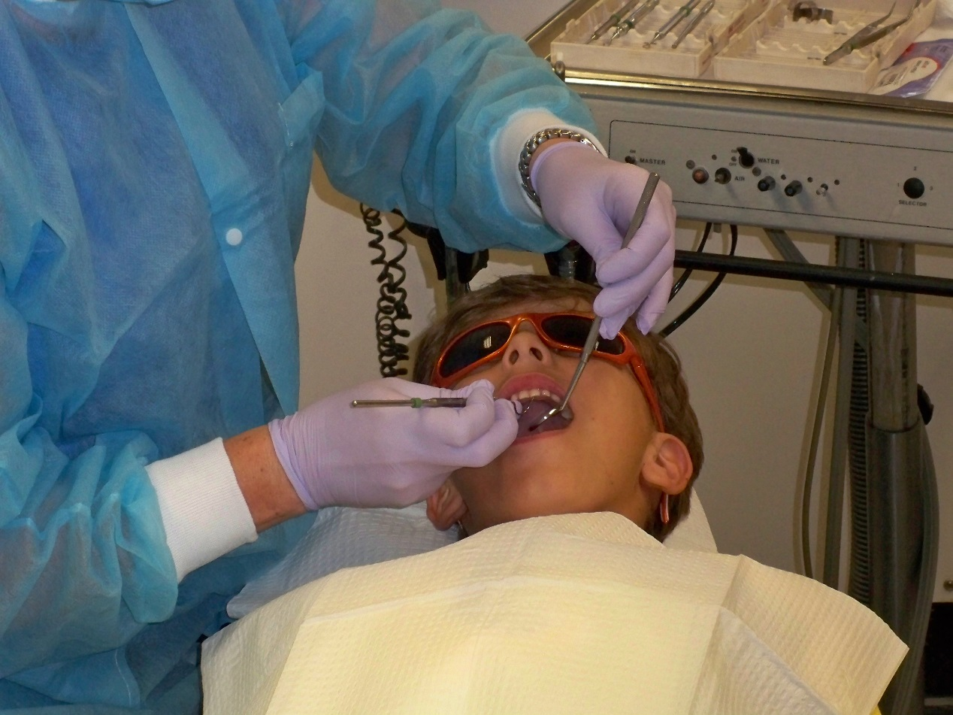
How can a dentist fix a cavity?

Slide 15

A dentist removes the decay and can place a filling.
What color do you think
fillings can be?

Slide 16
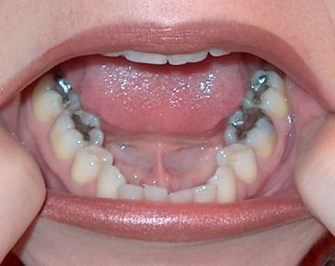
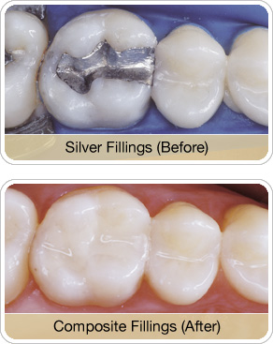
Silver Fillings

Slide 17
White Fillings

Slide 18
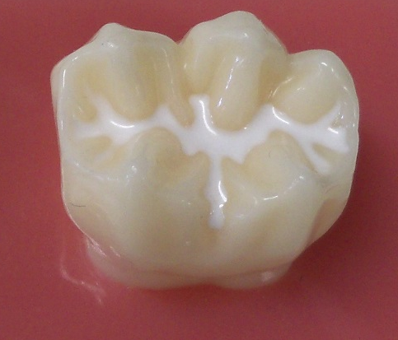
Raise your hand if you have had Sealants before?

Slide 19

SEALANTS

Slide 20
Besides causing cavities, do you think plaque can be harmful to our gums?
Does anyone know another name for gum disease?
?

Slide 21
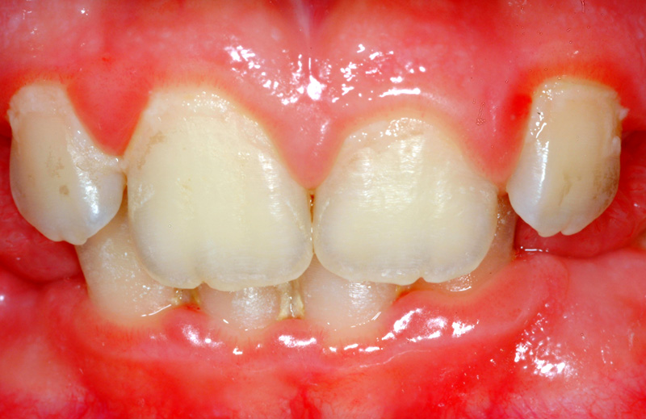
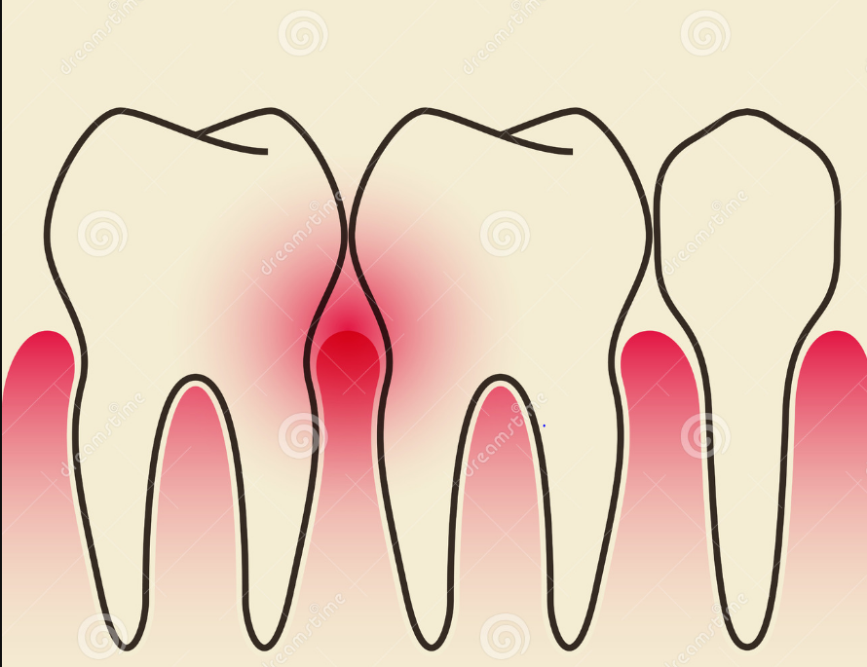
Gum Disease (Gingivitis)

Slide 22

How can we prevent cavities and gum disease?

Slide 23
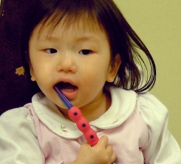
When should we brush our teeth?

Slide 24


Brush morning bedtime

Slide 25
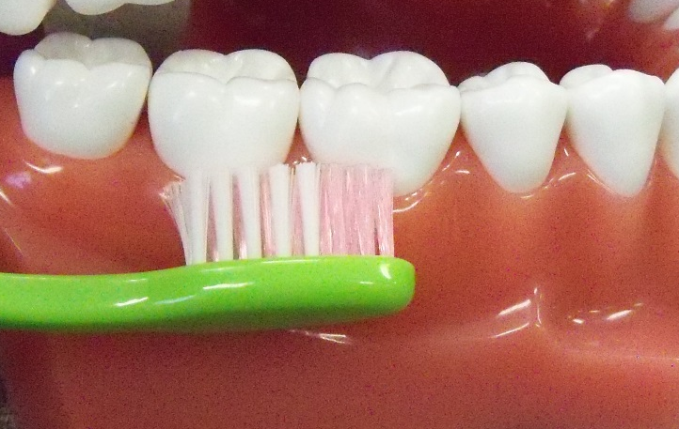
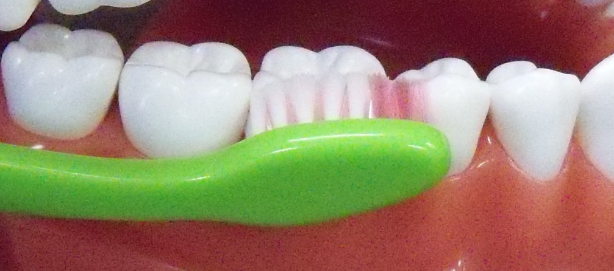
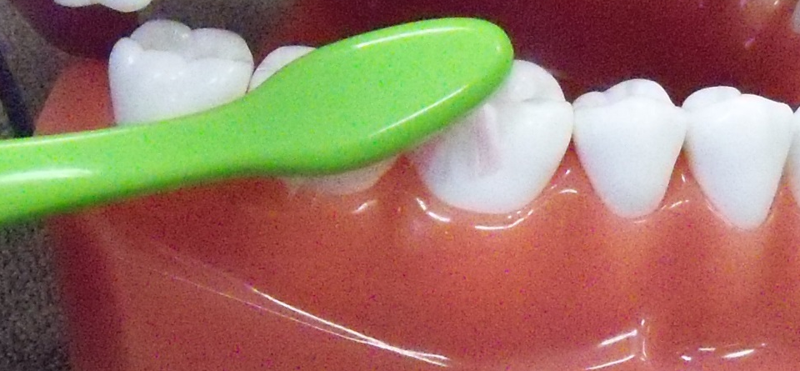
Brush in slow, small circles along the gumline

Slide 26

Brush All 3 Sides to Each Tooth
Outside, Inside and the Chewing Side

Slide 27

Brush the Outside

Slide 28
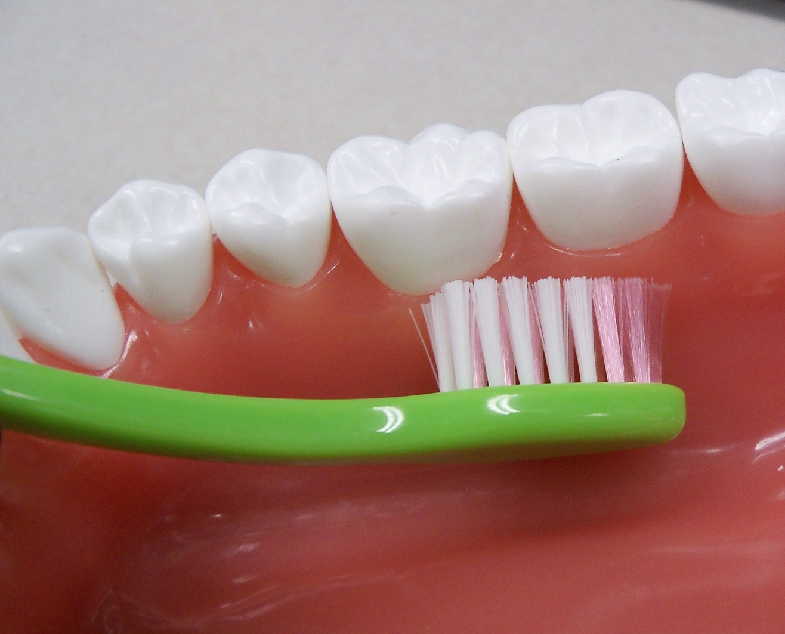
The Inside

Slide 29
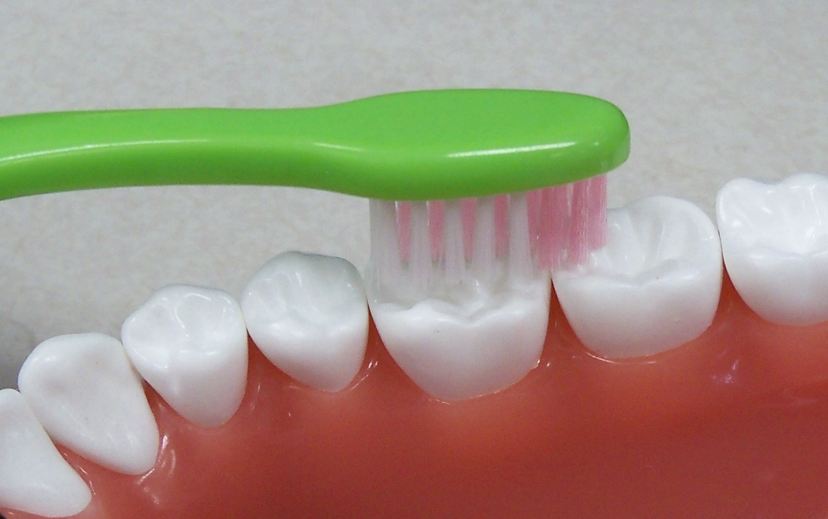
The Chewing Side

Slide 30
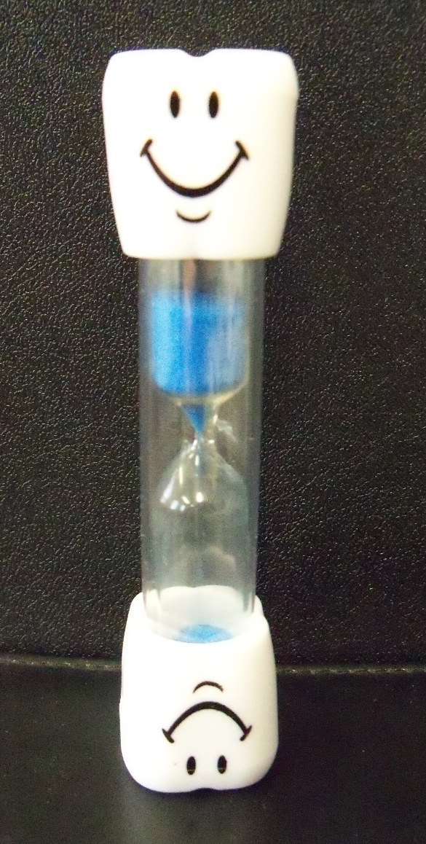
Brush for 2 Minutes

Slide 31
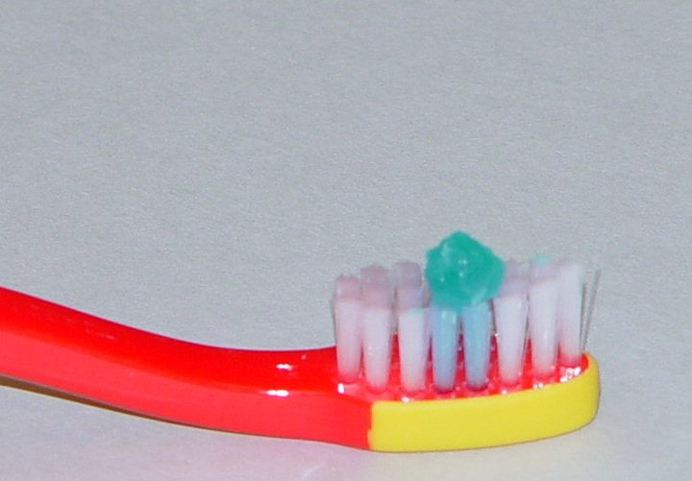
Use a small amount of fluoride toothpaste
Pea-size for children
3 years of age and older

Slide 32
How can we remove plaque between our teeth?

Slide 33
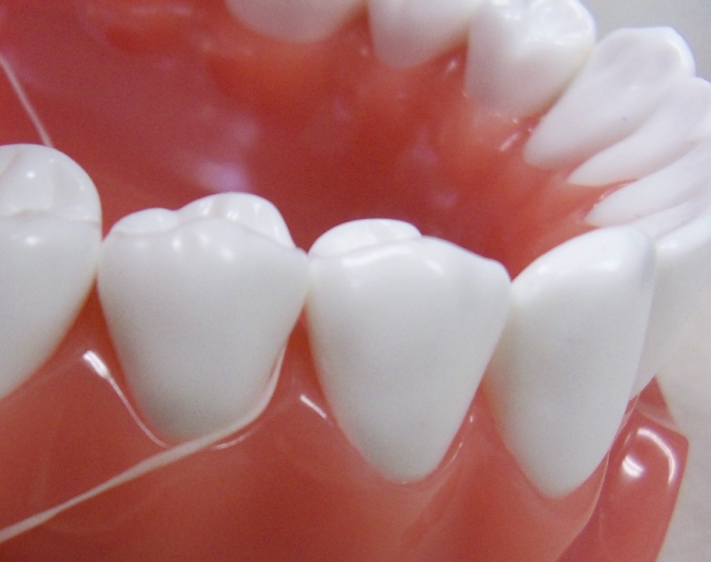
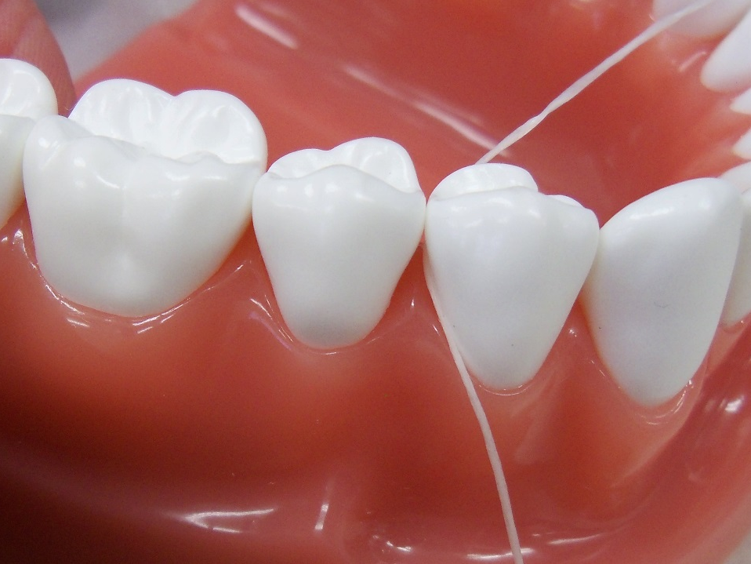
Flossing
Cleans between teeth
Once a day
Wrap floss around the tooth
Move floss up and down

Slide 34
Besides brushing and flossing to remove plaque, how else can we work to keep our teeth healthy?
Who do we go see to find out how healthy our teeth are?

Slide 35
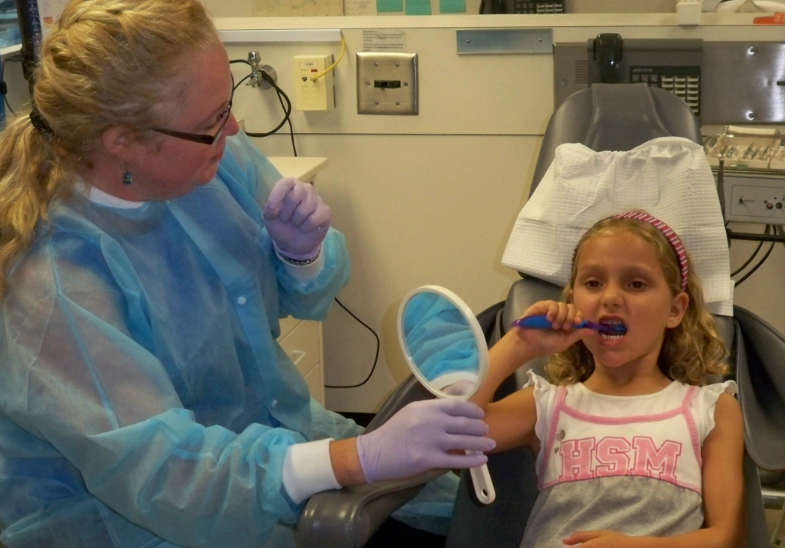
Visit the Dentist Regularly

Slide 36
Do the foods we eat affect how healthy our teeth are?
What ingredient is especially harmful to our teeth?
?

Slide 37
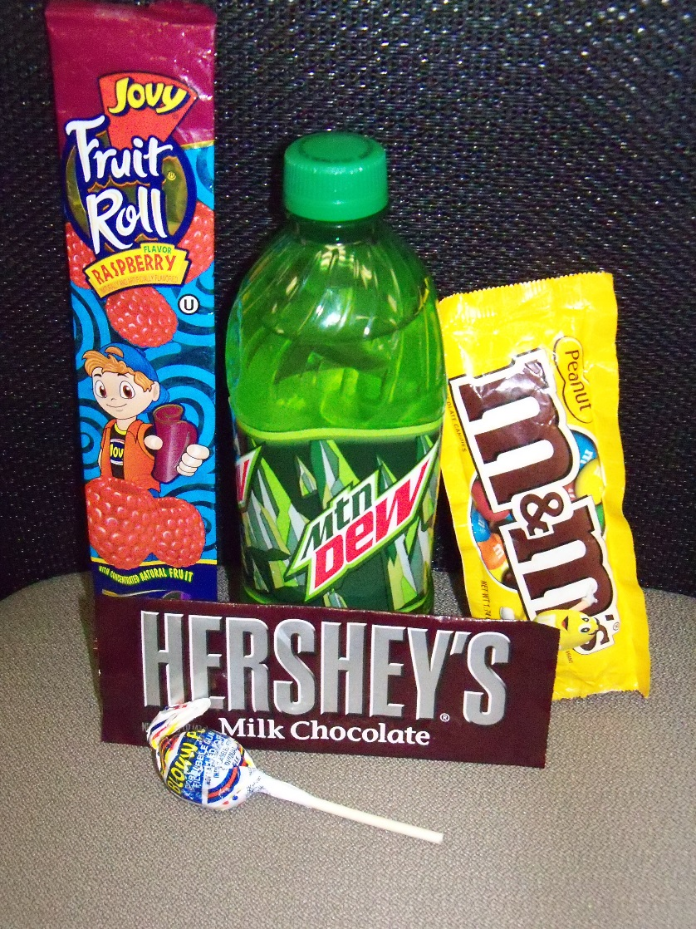
Try to limit sugary drinks and foods

Slide 38
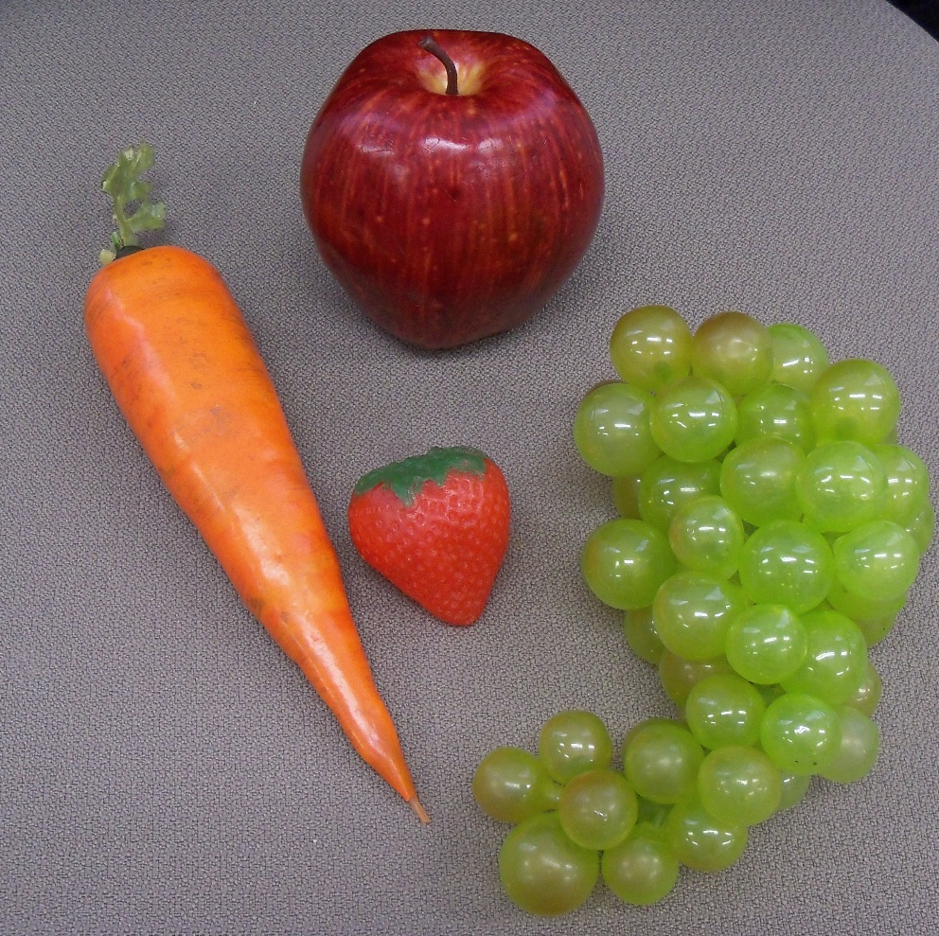
Fruits and vegetables make better snacks

Slide 39
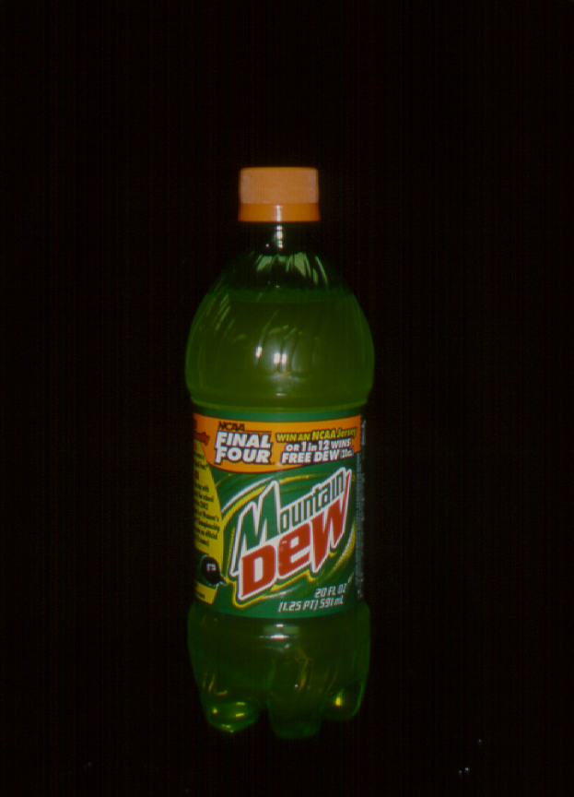
How much sugar is in
a 20 oz Mt. Dew?

Slide 40
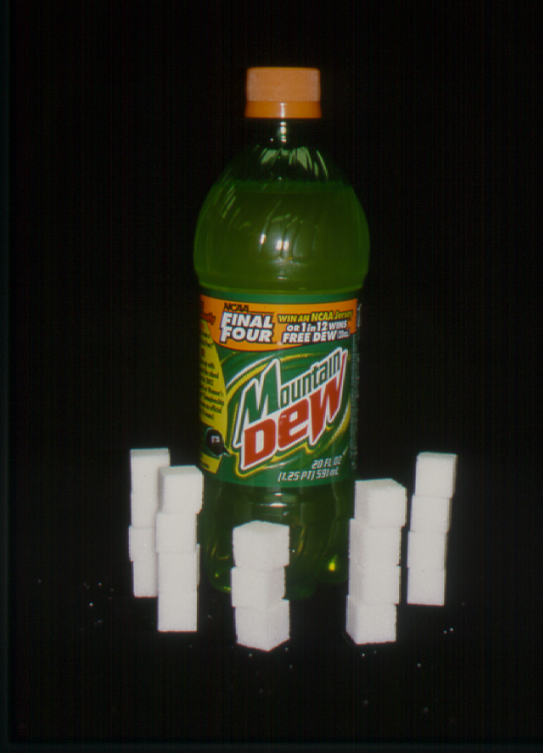
19 teaspoons
of sugar
90 mg of caffeine

Slide 41
Fluoride Helps Prevent Cavities
Where do we find fluoride?

Slide 42

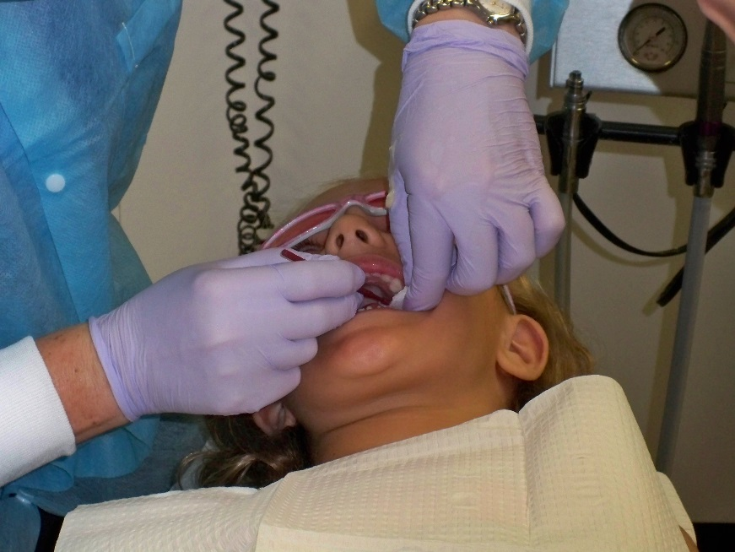


Toothpaste
At the Dentist
Mouthrinse
In Water

Slide 43

Raise your hand if your play sports?
What can you wear to protect your teeth during sports?

Slide 44
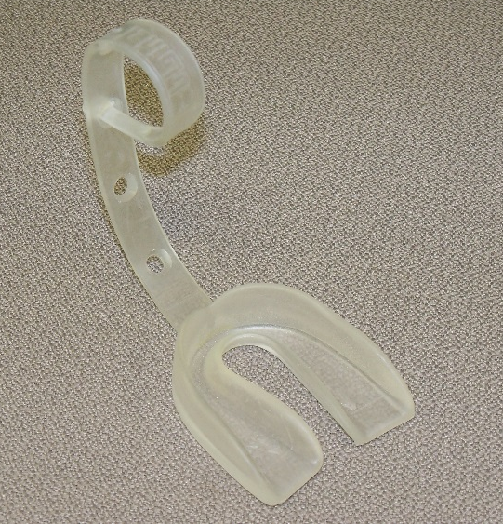
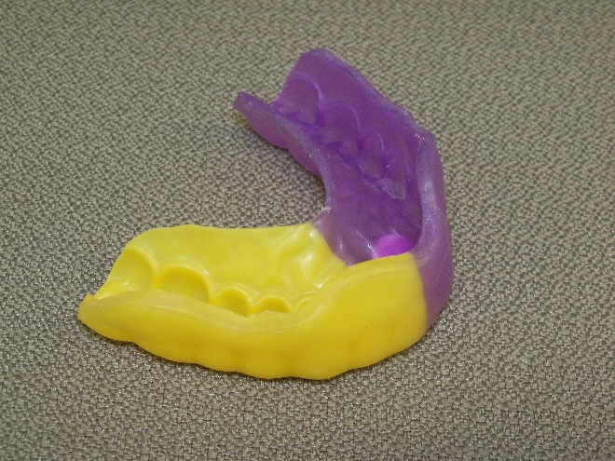
Mouthguards for Sports
Boil and Bite
Custom fit
made by a dentist

Slide 45

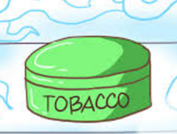
Do you think tobacco products can be unhealthy for your teeth and gums?
What might be some of the effects in the mouth if someone uses these products?

Slide 46
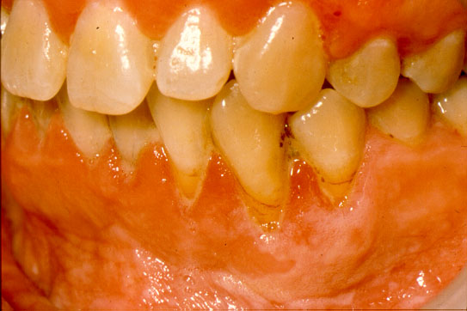
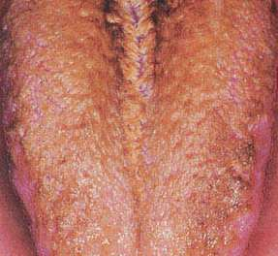
Can stain teeth
Gums can pull back
Tongue can turn dark
Can cause bad breath
Can lead to cancer

Slide 47

Keeping a Healthy Mouth
Brush and floss your teeth
Visit the Dentist regularly
Eat GOOD foods
Sealants
Fluoride
Mouthguards
No Tobacco
Make Smart Decisions

Slide 48

This presentation was made available by the
University of Iowa’s
Department of Pediatric Dentistry

